Slide 1

Super Market Order Analytics based on Shopping Trends
INFO6105 : Data Science Engineering Methods and Tools
Priyanka Bandekar
Prasham Shah
Prasanth Thota

Slide 2
Agenda
Introduction
Background Research
Objectives
Analysis methodology and Results
Conclusion

Slide 3

Introduction
Analysis of a customer purchase trend has often been an important sector for various businesses. It is an integral analysis from a vendor’s perspective as it governs the action behind tough decisions that contribute to the overall profitability for a business. Predicting the shopping capabilities for a customer, for many years, has been a prime area of application in the field of data mining.
Analytics frequently includes concentrating previous chronicled information to investigate potential patterns, to break down the impacts of specific choices or occasions, or to assess the performance of a given tool or situation.
This was the prime objective of this project, we examined verifiable information and anticipated a specific result dependent on that information. Right now, have executed different techniques to perform predictive analytics and attempt to improve the accuracy of the forecast.
Various python libraries like pandas, numpy and sklearn have been used in this project.

Slide 4
Background Research
Super Market Order Analytics based on Shopping Trends’ is about analyzing significant trends from the data.
It is additionally about predicting the items the user is most likely to purchase in their next order based on the products which have been purchased previously.
Shopping analytics can be done on several datasets including supermarket grocery store data, apparel store data etc.
For the purpose of this project, we have made use of ‘Instacart Market Basket Analysis’ dataset that is freely available on Kaggle.
Instacart market analytics was a Kaggle competition and the participants were supposed to predict the next purchase item.
Utilizing a range of machine learning algorithms, we have played out certain exploratory data analytics to figure out simple answers about the customer behavior.

Slide 5


Background Research
Some basic information concerning our dataset.
Instacart is a grocery ordering and delivery app that aims to make the product purchasing process easier for the customers. After selecting products through the Instacart app, personal shoppers review their order and do the in-store shopping and delivery for one.
The dataset has been provided by the ‘Instacart’ app where customers can order products from stores.
The data has a detailed depiction of the clients' orders over time.
The dataset is anonymized and contains a sample of over 3 million grocery orders from more than 200,000 Instacart clients.
For each user, we have been given somewhere in the range of 4 and 100 of their order, with the arrangement of items bought in each order.
We were also provided the week and hour of day the order was placed and an overall proportion of time between orders.

Slide 6
Background Research
There are 6 files provided by Instacart as given below:
● Aisles.csv – This file contains two columns – aisle_id and aisle. It contains data regarding the name of the aisle along with a unique id associated with each aisle
● Departments.csv – This file contains two columns – department_id and department. It contains data concerning the name of the department and an associated unique id for each department of a product
● Order_Product__Prior.csv – This file contains four columns – order_id, product_id, add_to_cart_order and reordered. These files specify which products were purchased in each order. order_products__prior.csv contains previous order contents for all customers. 'reordered' indicates that the customer has a previous order that contains the product
● Order_Product__Train.csv – It has a schema that is similar to the order_products_prior. This file includes the dataset that will be used to train the test dataset.
● Orders.csv – This file contains seven columns – order_id, user_id, eval_set, order_number, order_dow, order_hour_of_day and days_since_prior_order. This file tells us to which set (prior, train, test) an order belongs. We are predicting reordered items only for the test set orders and 'order_dow' is the day of week.
● Products.csv – This file contains four columns – product_id, product_name, aisle_id and department_id. It includes data regarding the products sold by the business.

Slide 7
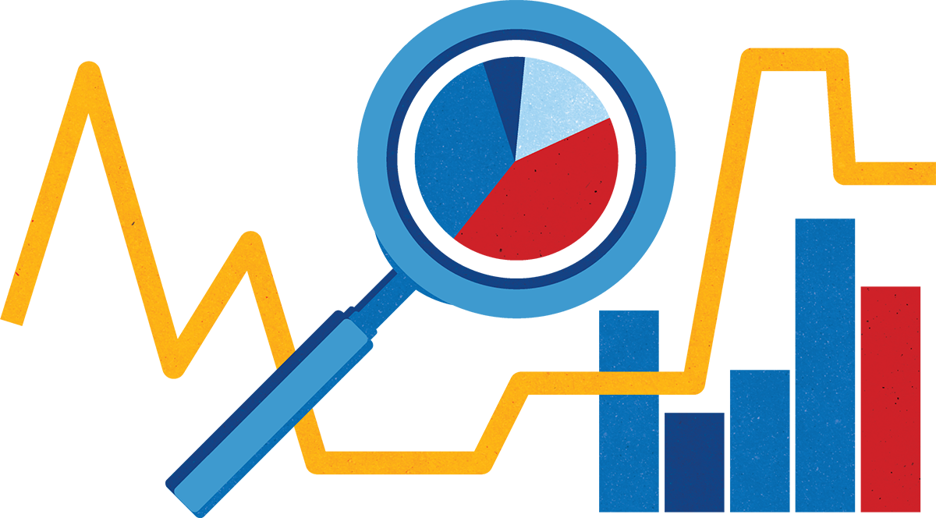
Objectives
In this project, we aim to identify hidden patterns in the data, explore any useful relationships between the data, find out any inconsistencies in the data, cleaning the data and using the consistent data to provide intuitive information from the analysis.
The main goal of this project is to predict whether a customer will reorder a particular product based on his previous orders.
To satisfy the above requirements we have performed the following analytics on the Instacart dataset:
Exploratory data analysis
Logistic Regression
Random Forest
Gradient boost method
Clustering
Apriori Algorithm
K-Nearest Neighbours

Slide 8
Analysis Methodology and Results
Exploratory data analysis
After performing the Exploratory Data Analysis, we found out that we were able to extract some important trends and features related to the various progressions in the trends for the customer’s order.
While performing Exploratory data analytics, we were able to make sense out of a great deal of helpful data which for the most part would not have been on display.
We had the option to discover more problem statements and find out the answers by analysis of the data.
According to our discoveries after performing exploratory data analysis, we were able to gather useful insights regarding the purchase behavior for a customer.
We were able to discover the days and hours of the week when customers tend to buy products, most bought products, etc.

Slide 9
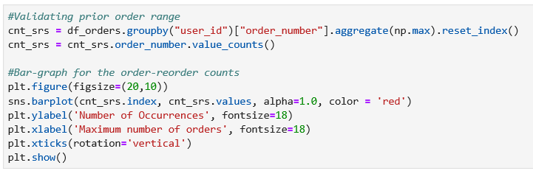
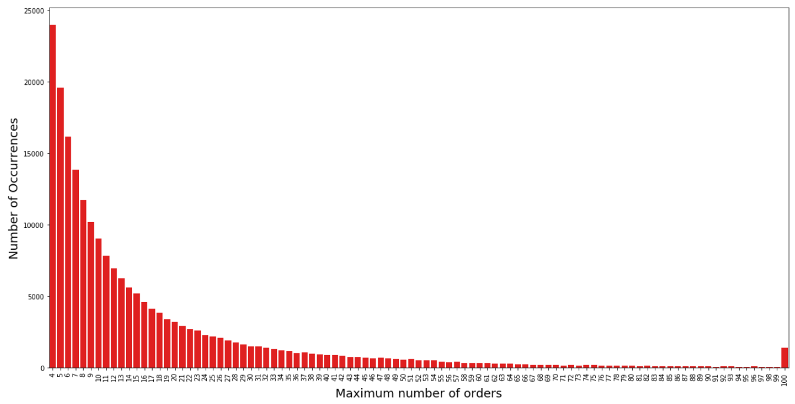
Analysis Methodology and Results
Maximum Number of products in an order We were able to know what was the cart size of a customer when placing an order.

Slide 10
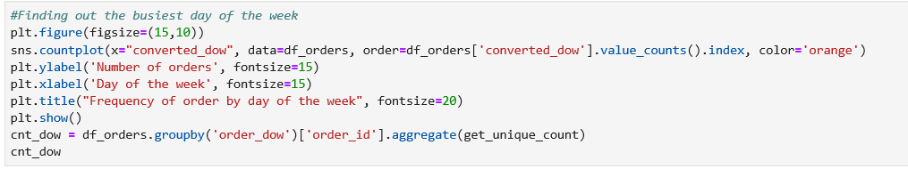
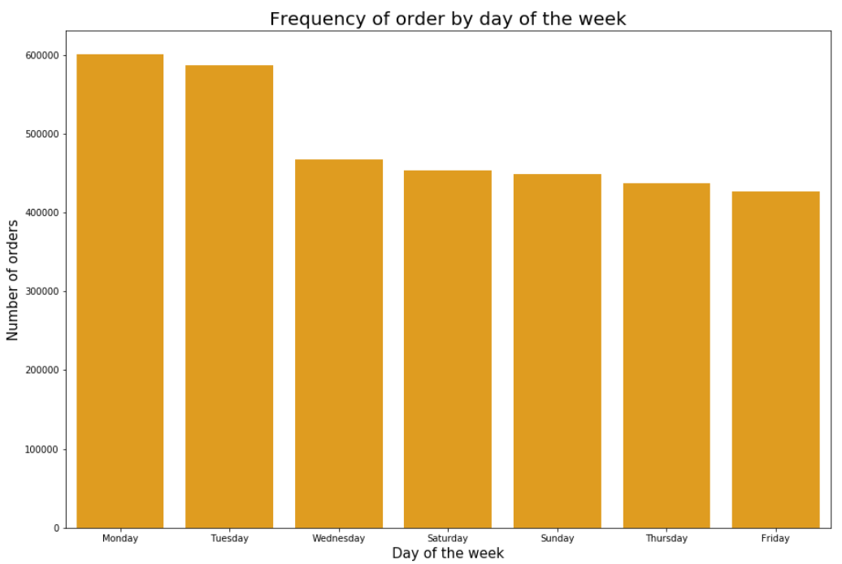
Analysis Methodology and Results
Frequency of Orders based on day of the week We were able to know that people were generally ordering groceries during the weekend and were being delivered during the start of the week. This makes sense as people are generally busy during the weekdays.

Slide 11
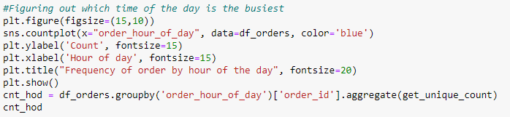
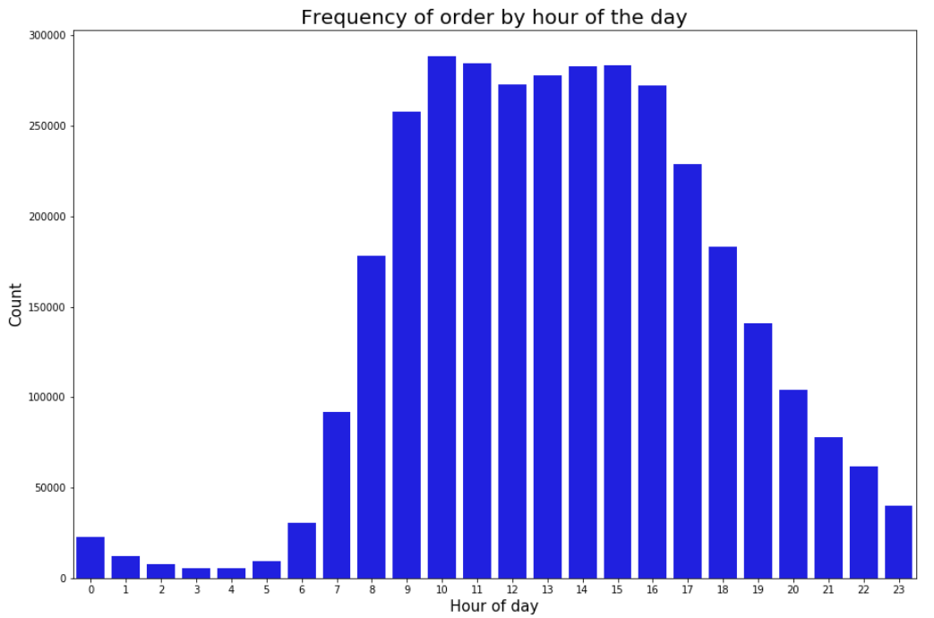
Analysis Methodology and Results
Frequency of Orders based on hour of the day People generally tend to order during the morning to afternoon times (10AM-5PM) rather than in the evening or night time.

Slide 12
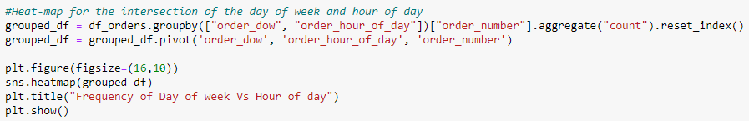
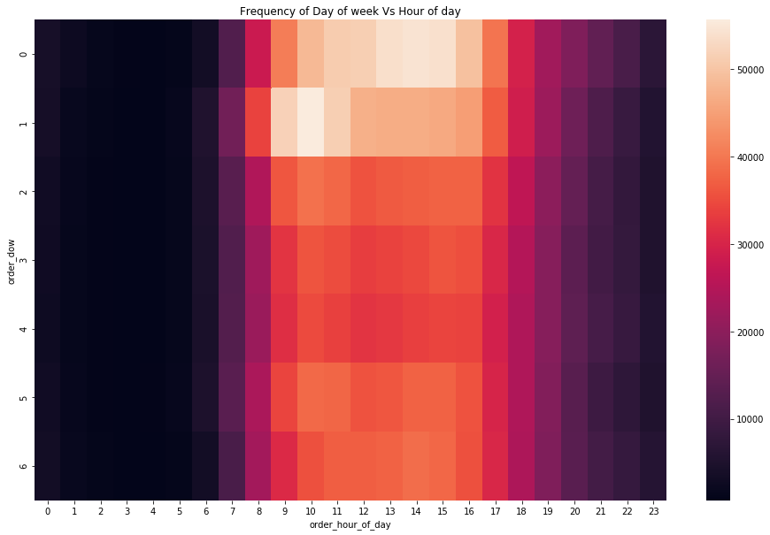
Analysis Methodology and Results
Peek hours of the week heatmap People generally tend to order during the during 10:00 AM to 3:00 PM on Monday and Tuesday

Slide 13
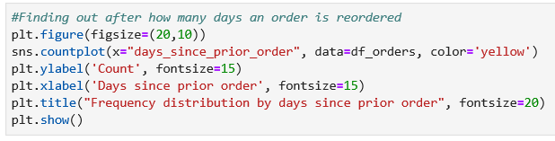
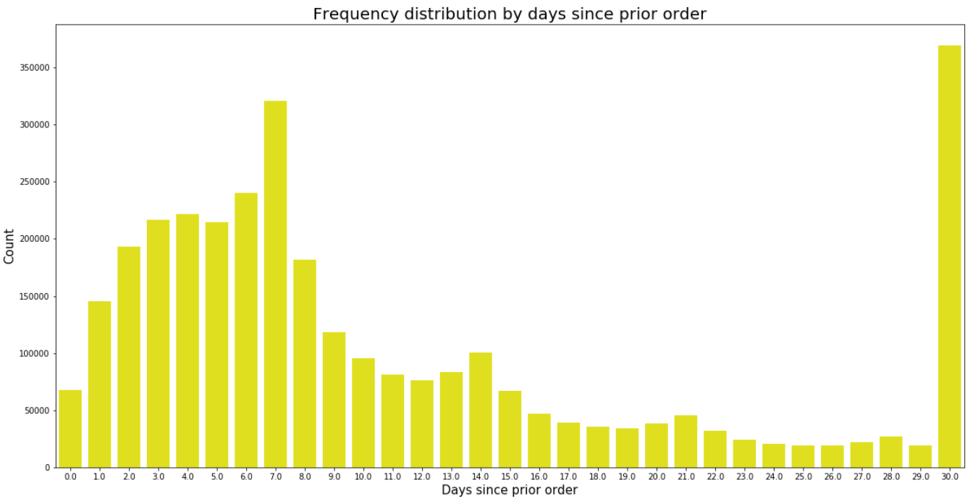
Analysis Methodology and Results
Re-ordering frequency of customers People generally tend to re-order the products generally every week and every month

Slide 14
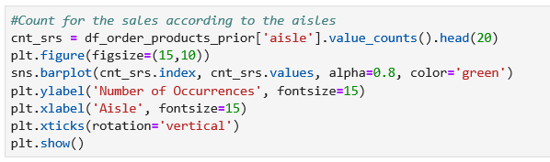
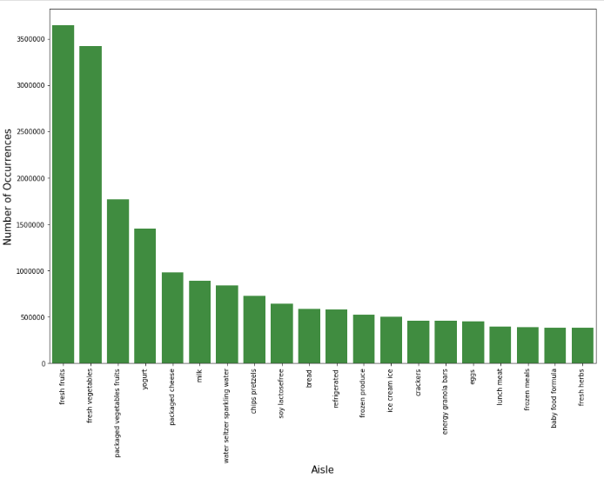
Analysis Methodology and Results
Frequently bought products by customers It is seen that people tend to order fresh vegetables and fruits from the Instacart app.

Slide 15
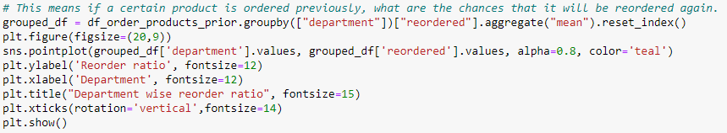
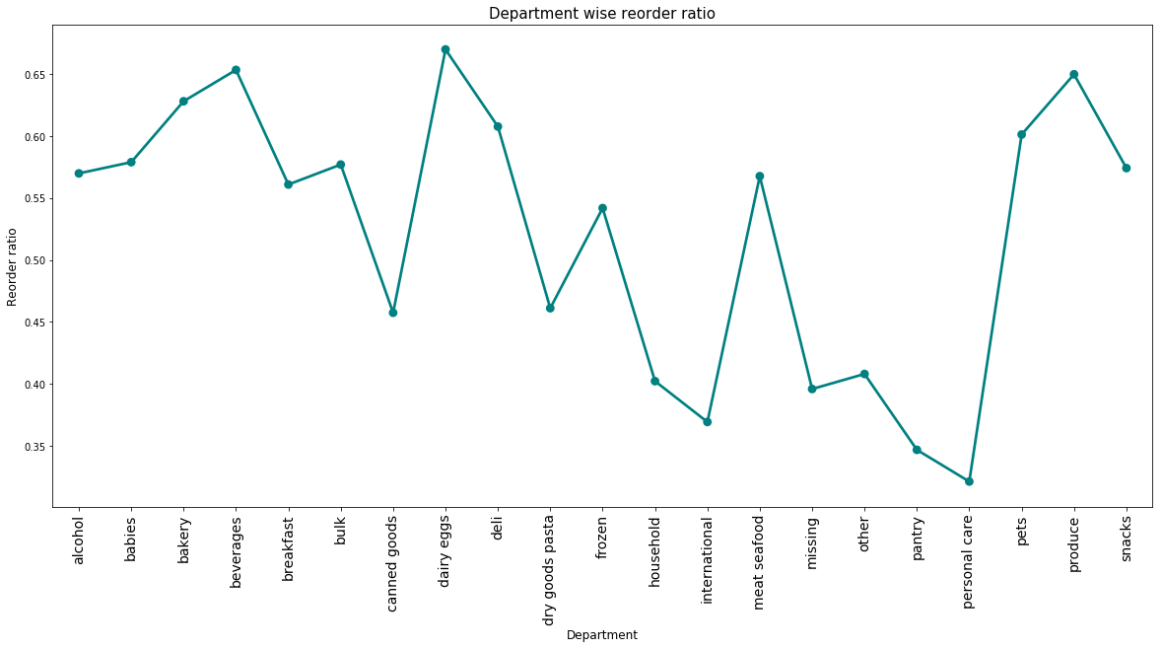
Analysis Methodology and Results
Frequently re-ordered products by customers It is seen that people tend to re-order dairy eggs, beverages and produce (fruits and vegetables)

Slide 16
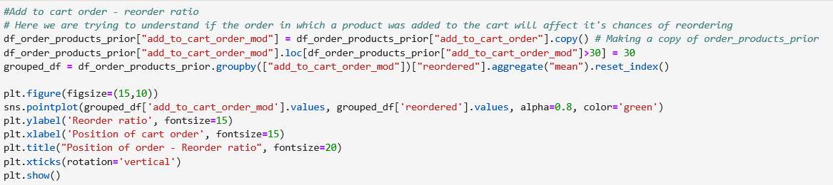
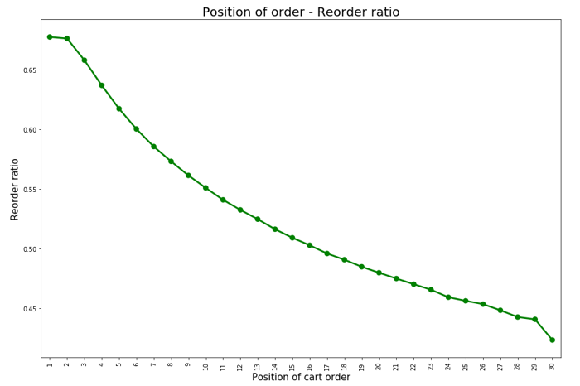
Analysis Methodology and Results
Order cart position of re-ordered products by customers It is seen that people tend to put re-ordered items at the beginning of cart and then look for other products.

Slide 17
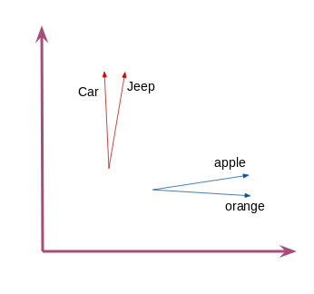
Analysis Methodology and Results
Word2Vec
Word2vec is a two-layer neural net that processes text. Its input is a text corpus and its output is a set of vectors: feature vectors for words in the corpus.
Similar things and ideas are shown to be “close”. Their relative meanings have been translated to measurable distances.
We have used this method to extract the information about the relationship between products ordered by customers.
We performed feature engineering to implement Word2Vec from the Gensim model. This model helped us in clustering products, and this is of huge help in recommendation systems.

Slide 18
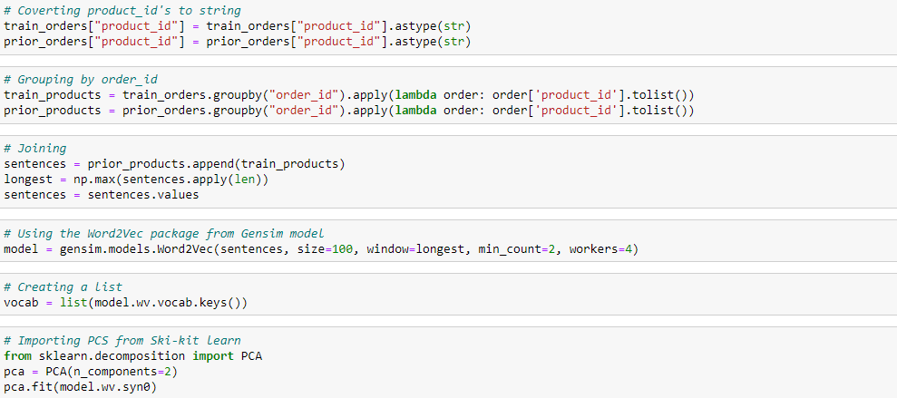
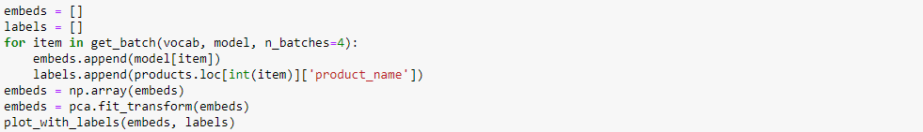
Analysis Methodology and Results
Word2Vec

Slide 19
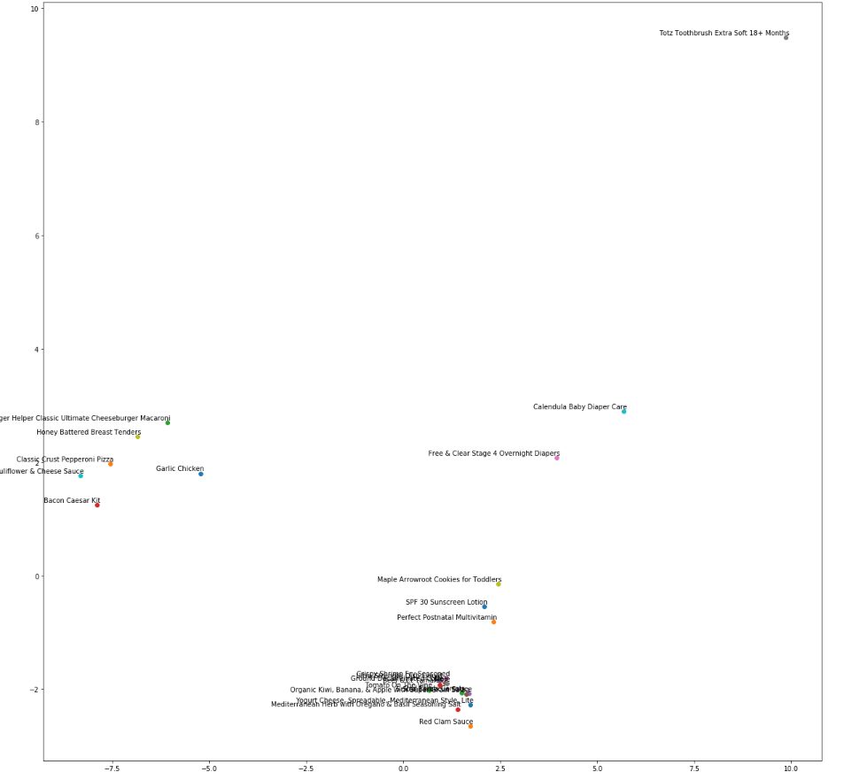
Analysis Methodology and Results
Word2Vec

Slide 20
Analysis Methodology and Results
Predicting re-order by customer based on previous orders
For making the learning algorithm work adequately we have performed a couple of steps to the data as given below:
Step 1: Importing the orders data.
Step 2: Creating data frame with old purchase.
Step 3: Creating a data frame with latest purchase data.
Step 4: Counting of Number of reorders of customers.
Step 5: Merging the prior data frame with latest data frame.
Step 6: Extracting the distinct order ids in data frame. Then we will join the data frame with orders
Step 7: Preparing test data frames
Step 8: Merging the train and test data with prior data frame to extract the products purchased previously by the customer.
Step 9: Adding more features to training data from Products data frame
Step 10: Splitting data into train and test sets

Slide 21
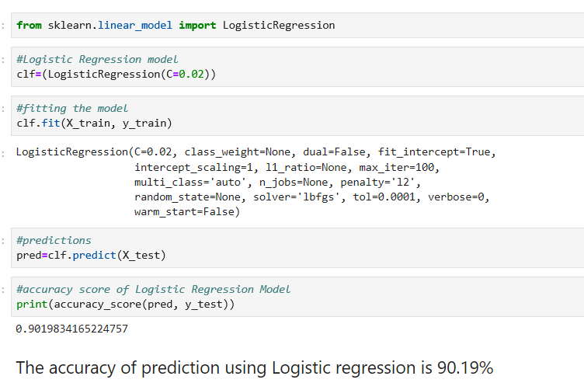
Analysis Methodology and Results
Logistic Regression
Logistic regression is a statistical model that in its basic form uses a logistic function to model a binary dependent variable which is re-ordering a certain product, although many more complex extensions exist.
Using Logistic Regression method for this dataset was accurate to some extent but was not the best approach since there was no Boolean type data in the dataset.
The accuracy achieved using this method was 90.19%

Slide 22
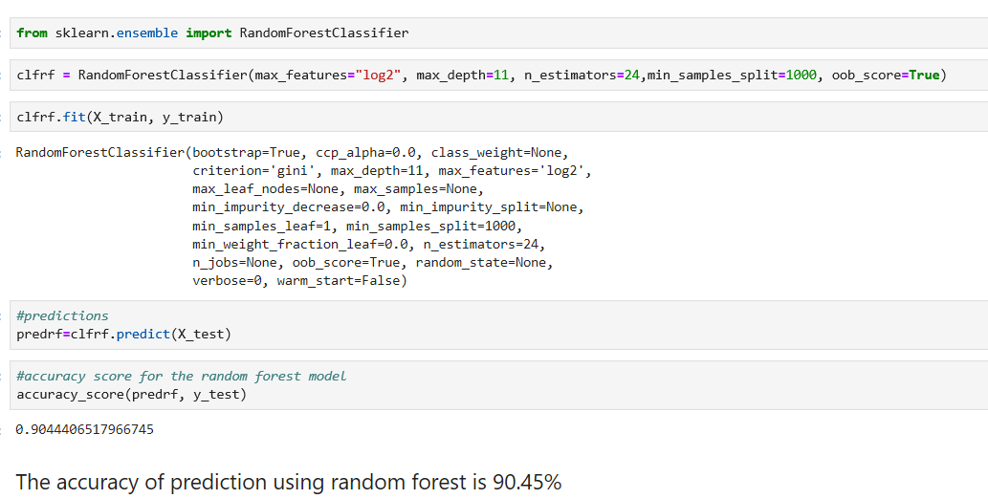
Analysis Methodology and Results
Random Forest
Random forests or random decision forests are an ensemble learning method for classification, regression and other tasks that operates by constructing a multitude of decision trees at training time and outputting the class that is the mode of the classes (classification) or mean prediction (regression) of the individual trees.
Random Forests did not prove to be very accurate because the decision trees did not provide any meaningful output. The model would be getting over-fitted sometimes.
The accuracy achieved using this method was 90.45%

Slide 23
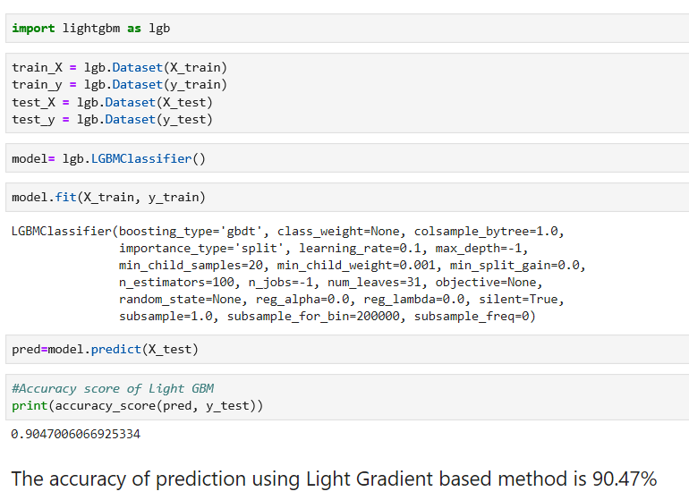
Analysis Methodology and Results
Light GBM (using clustering)
Gradient boosting is a machine learning technique for regression and classification problems, which produces a prediction model in the form of an ensemble of weak prediction models, typically decision trees.
We have seen that GBM was able to fairly accurate results related to predicting whether a product will be re-ordered or not
The accuracy achieved using this method was 90.47%

Slide 24
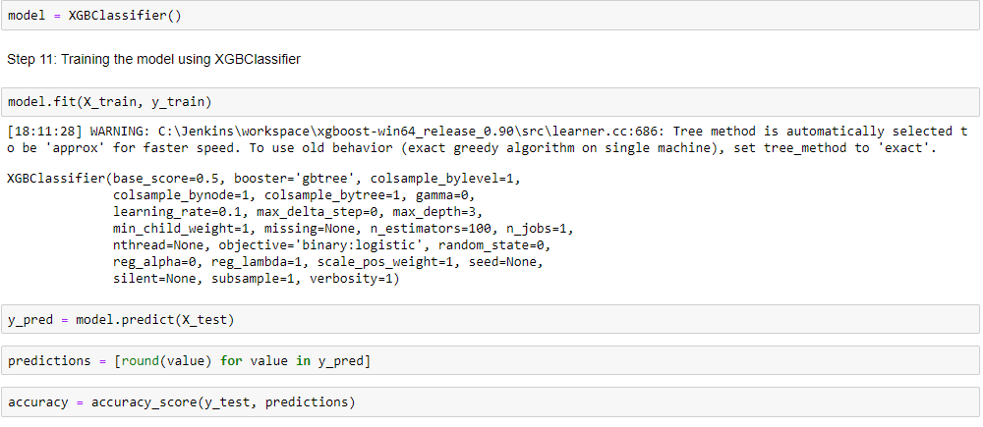
Analysis Methodology and Results
XGBoost Library
XGBoost is an optimized distributed gradient boosting library designed to be highly efficient, flexible and portable. It implements machine learning algorithms under the Gradient Boosting framework.
We have seen that the XGBoost classifier was able to give reasonably accurate results and also optimize the computation time of machine learning.
The accuracy achieved using this method was 90.43%

Slide 25
Analysis Methodology and Results
Apriori Algorithm
Apriori is an algorithm for frequent item set mining and association rule learning over relational databases.
It proceeds by identifying the frequent individual items in the database and extending them to larger and larger item sets as long as those item sets appear sufficiently often in the database.
Here we have used it to find associative rules based on what products the customers tend to order together.
We have observed that the customers tend to order a set of items together with a higher probability compared to others.
The results related the associative ordering probability of certain products can be seen in the list in the following slide.

Slide 26
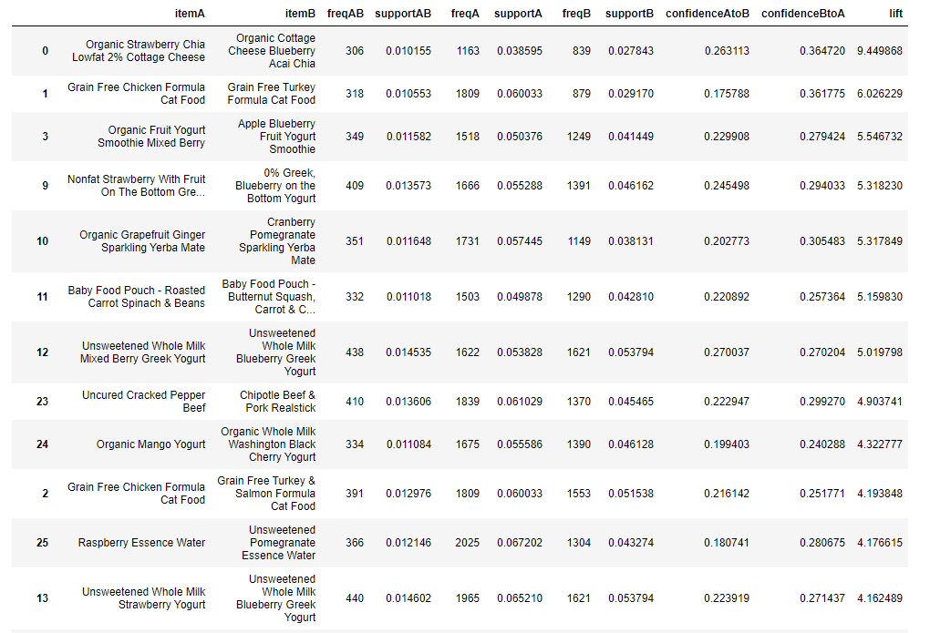
Analysis Methodology and Results
Apriori Algorithm

Slide 27
Analysis Methodology and Results
K-Nearest Neighbours
K-Nearest Neighbour is one of the simplest Machine Learning algorithms based on Supervised Learning technique. It assumes the similarity between the new case/data and available cases and put the new case into the category that is most similar to the available categories.
The algorithm stores all the available data and classifies a new data point based on the similarity. This means when new data appears then it can be easily classified into a well suite category by using K- NN algorithm. K-NN algorithm can be used for Regression as well as for Classification but mostly it is used for the Classification problems.
Here this technique has been utilized to group if an item will be re-requested or not.

Slide 28
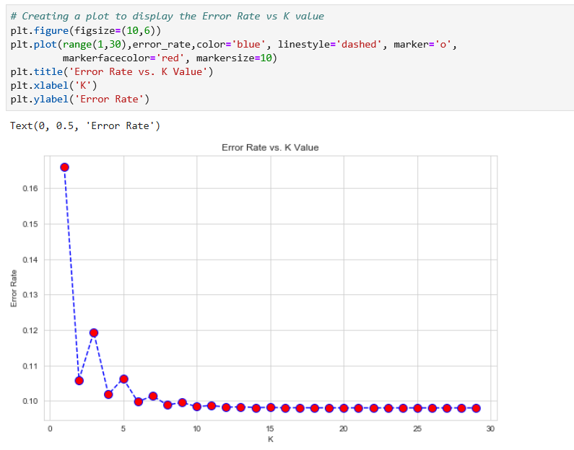
Analysis Methodology and Results
K-Nearest Neighbours

Slide 29
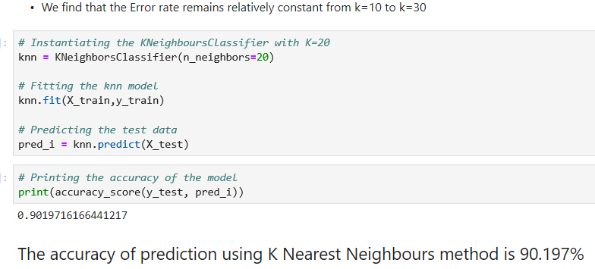
Analysis Methodology and Results
K-Nearest Neighbours

Slide 30
Conclusion
We have seen that using the powerful tools like Data exploratory analysis and certain machine learning algorithms can be used to get valuable insights about the customers’ shopping behavior.
It is very profitable for companies to use the tool of data analytics to understand trends in sales and customers’ behavior, as it can be used to accurately forecast product related sales information.
Some important trends observed from the data set analyzed are:
Busiest days of week: Monday and Tuesday
Busiest Hours of Day: 10AM to 11AM
Most Popular Products: Bananas and Organic Bananas
Most Popular Department: Produce
Most Popular Aisle: Fresh Fruits
Most Re-ordered Product: Dairy Eggs

Slide 31
Conclusion
Most Frequently Ordered Product Pairs: Red Onion and Bag of Organic Bananas
Minimum number of orders per customer is 4 while maximum is 100
Average Frequency of Reordering: Weekly and Monthly
Average percentage of products which are reordered: 59%
Average number of products per order: 5
Best model for prediction: Gradient Boost classifier
Highest accuracy achieved: 90.47%
Products ordered together frequently:
Different types of cottage cheese
Different types of cat food
Different types of Smoothies
Different types of Yoghurt
Different types of Sparkling Yerba
Different types of baby food

Slide 32
Questions?

